Slide 1
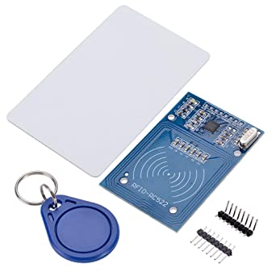
REQUIREMENT SPECIFICATION:
RFID or Radio Frequency Identification system consists of two main components, a transponder/tag attached to an object to be identified, and a Transceiver also known as interrogator/Reader. A Reader consists of a Radio Frequency module and an antenna which generates high frequency electromagnetic field.
RFID MODULE
The basic concept of operation is:
An antenna sends out and receives radio signals.
These signals are received and returned by an RFID tag with information added.
A reader which is integrated with a system accepts and stores these data called events and finally, they trigger actions.

Slide 2
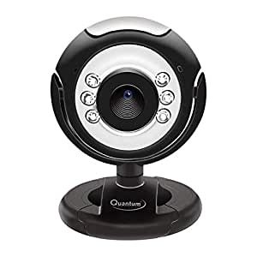
WEB CAMERA:-
A webcam is a digital video device commonly built into a computer. Its main function is to transmit pictures over the Internet. It is popularly used with instant messaging services and for recording images.
Image processing techniques use filters to enhance an image. Their main applications are to transform the contrast, brightness, resolution and noise level of an image. Contouring, image sharpening, blurring, embossing and edge detection are typical image processing functions

Slide 3
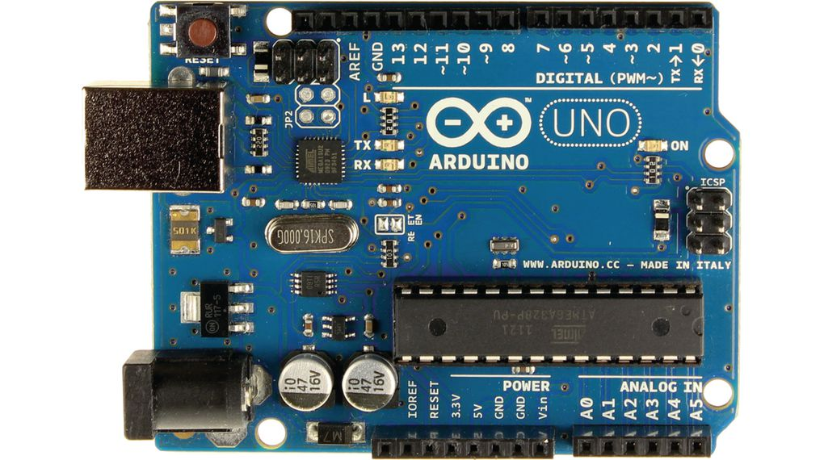
Arduino UNO:-
Features of the Arduino UNO:
Microcontroller: ATmega328
Operating Voltage: 5V
Input Voltage (recommended): 7-12V
Input Voltage (limits): 6-20V
Digital I/O Pins: 14 (of which 6 provide PWM output)
Analog Input Pins: 6
DC Current per I/O Pin: 40 mA
DC Current for 3.3V Pin: 50 mA
Flash Memory: 32 KB of which 0.5 KB used by bootloader
SRAM: 2 KB (ATmega328)
EEPROM: 1 KB (ATmega328)
Clock Speed: 16 MHz
Arduino uno is an open-source electronics platform based on easy-to-use hardware and software. Arduino boards are able to read inputs - light on a sensor, a finger on a button, or a Twitter message - and turn it into an output - activating a motor, turning on an LED, publishing something online.

Slide 4
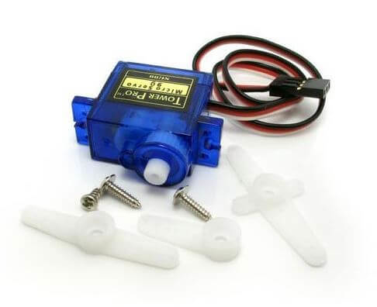
SERVO MOTOR:-
Servo motors or “servos”, as they are known, are electronic devices and rotary or linear actuators that rotate and push parts of a machine with precision. Servos are mainly used on angular or linear position and for specific velocity, and acceleration.
Why is it called a servo motor?
Definition of servo motor In other words, servo motors get their name from the fact that they can be relied upon to operate "exactly as commanded". Any electric motor capable of controlling parameters like position and speed is called a servo motor, regardless of how this control is achieved.

Slide 5
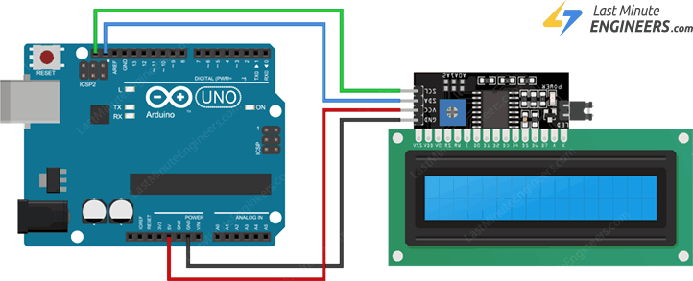
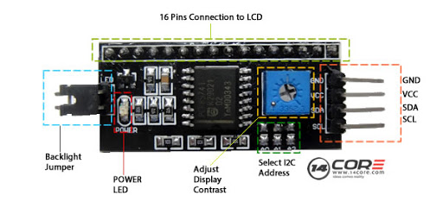
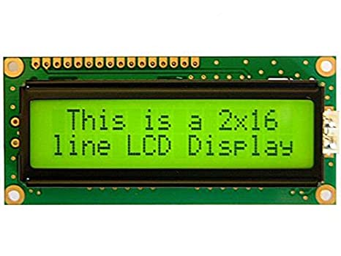
I2c module and lcd display:-
I2C_LCD is an easy-to-use display module, It can make display easier. Using it can reduce the difficulty of make, so that makers can focus on the core of the work. We developed the Arduino library for I2C_LCD, user just need a few lines of the code can achieve complex graphics and text display features.

Slide 6
Screenshots:- ( so far)

Slide 7
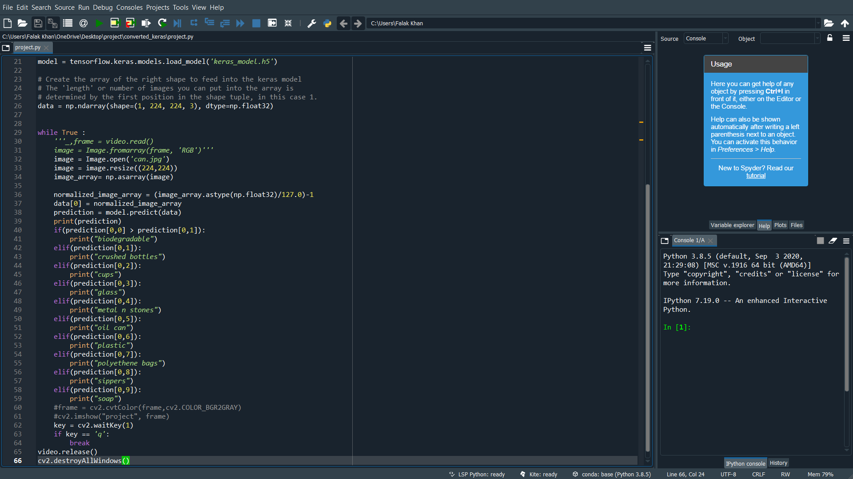

Slide 8
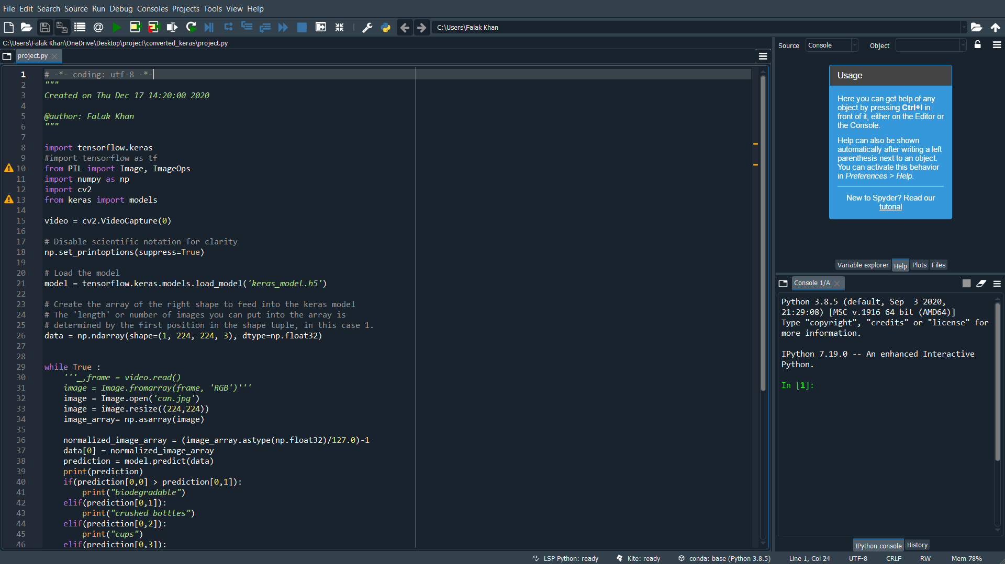

Slide 9
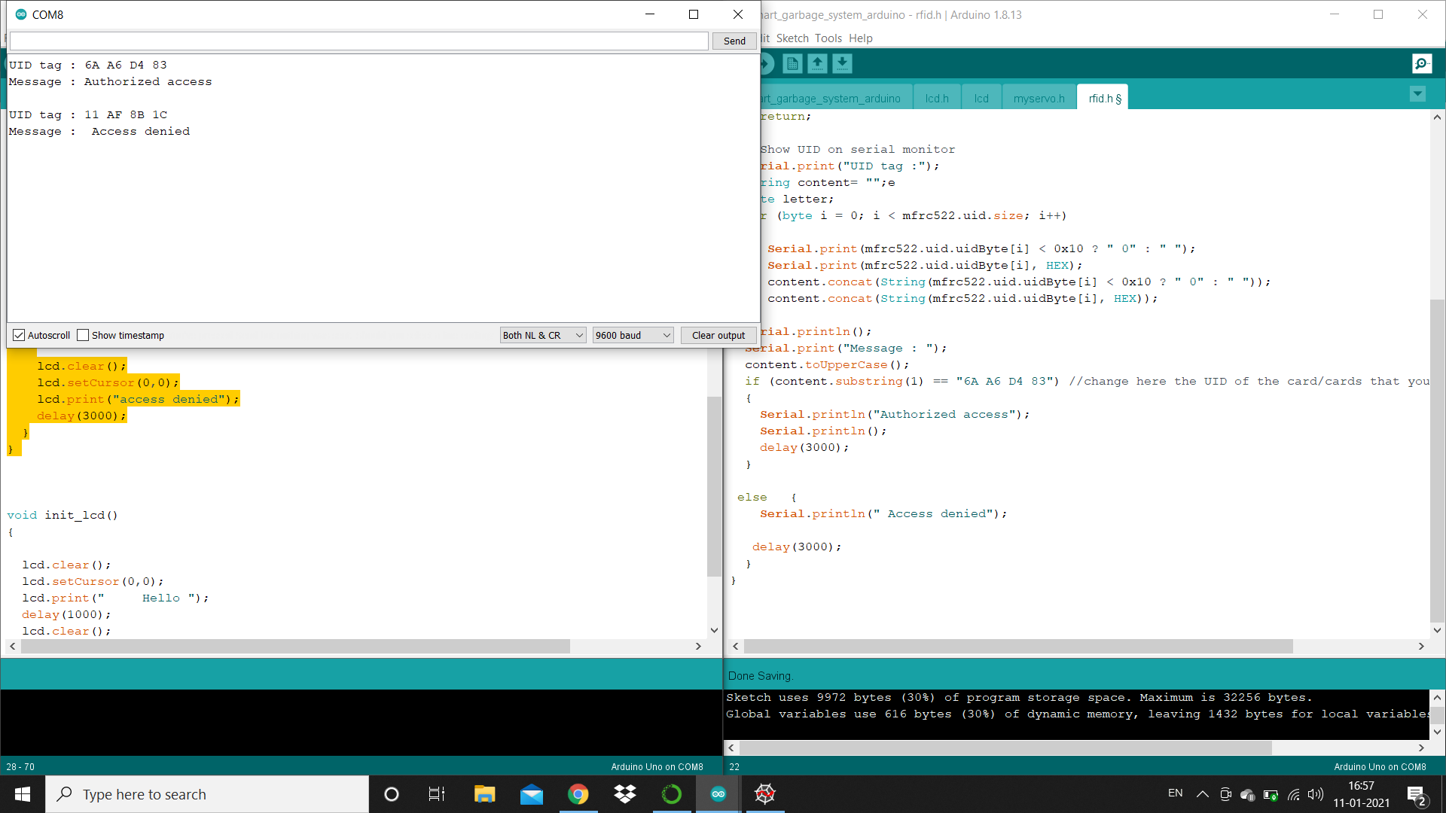

Slide 10
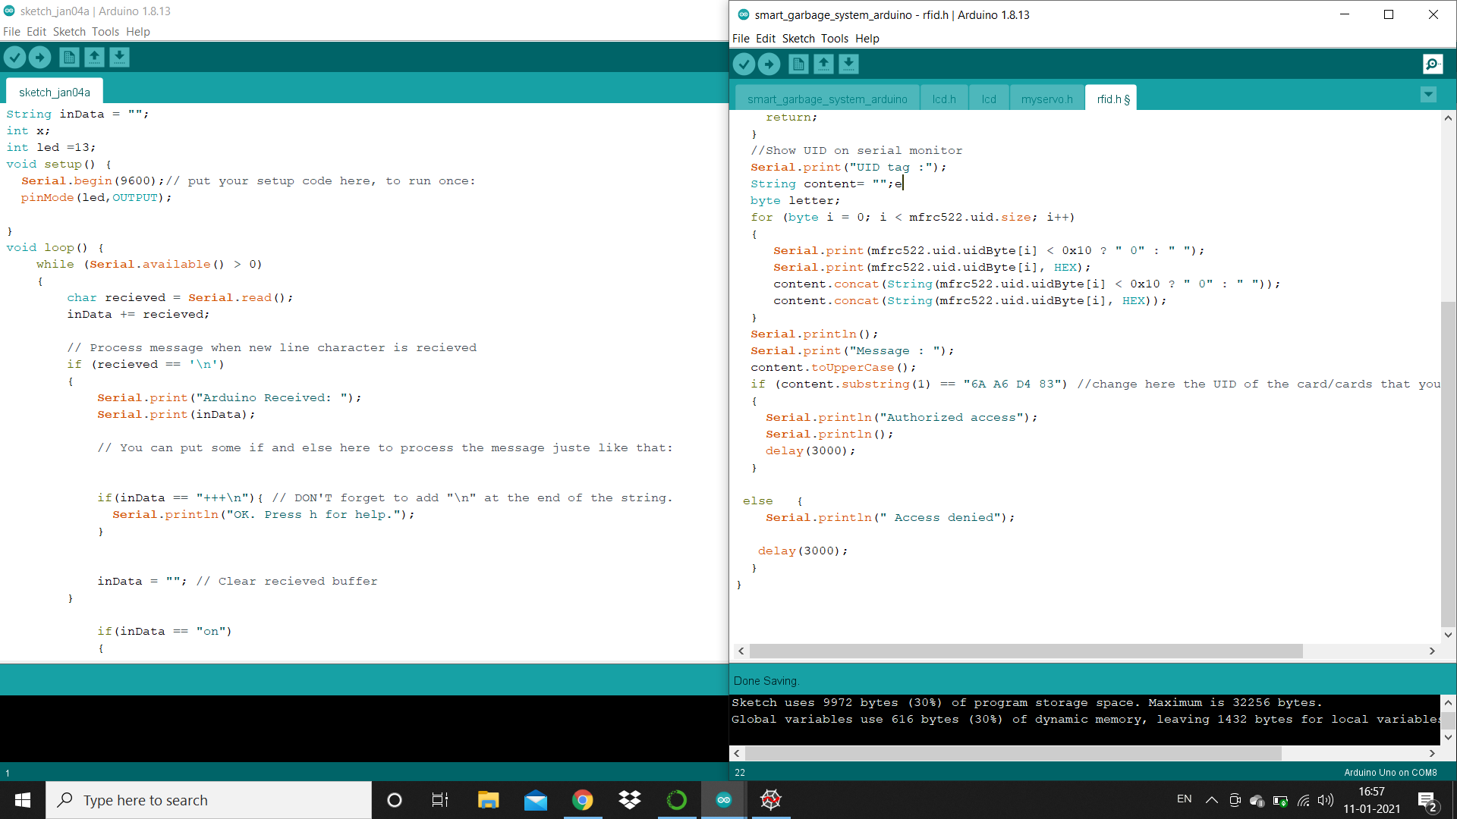

Slide 11
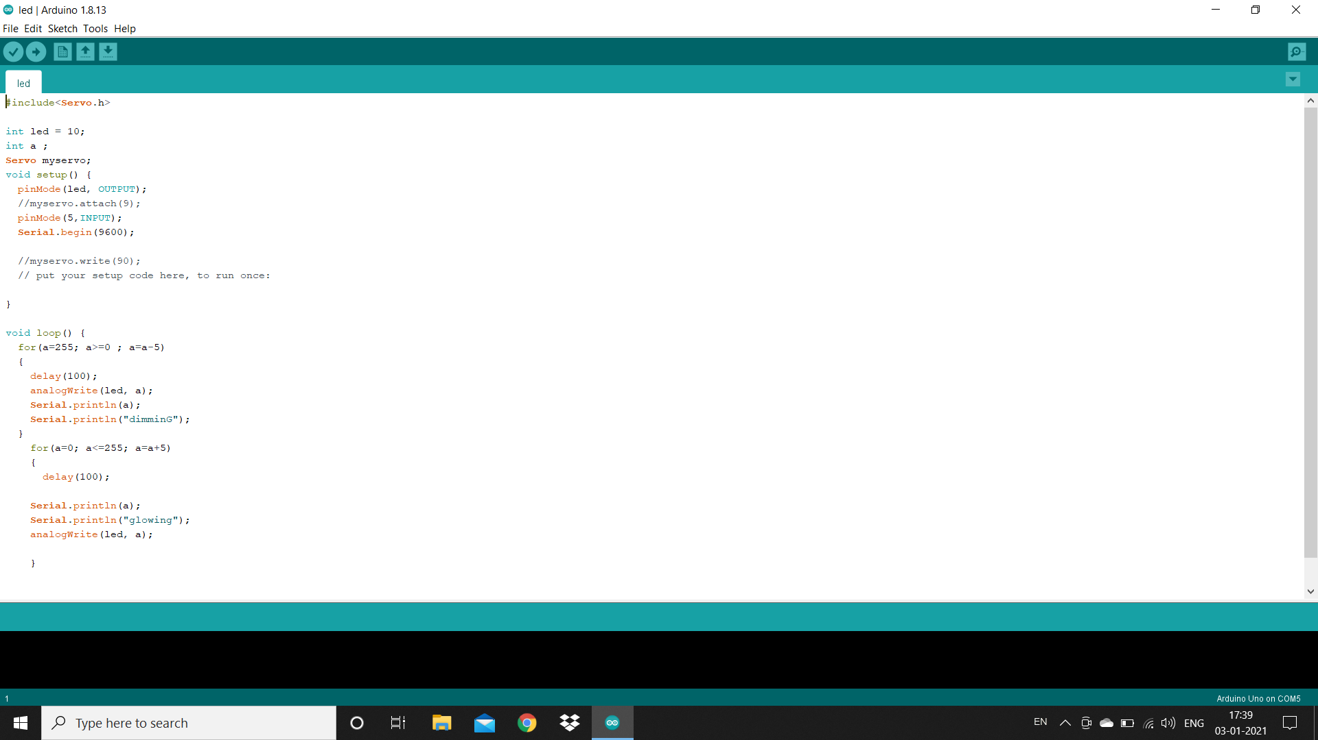

Slide 12
CONCLUSION AND FUTURE ENHANCEMENT:
•In this project, a prototype of the Smart Plastic Recycle Machine is successfully simulated. User inputs plastic material into the system, the system enables the summation of points throughout the recycling process.
•
• The reward coins and weight of plastic increment with every input to the system. If the user inputs an invalid object or invalid type item into the system, system cannot except the input material and reset the system.
•
•The system will work efficiently and cost effective in implementing the design of creating the recycle machine’s programmable hardware-based detection system using image processing. The future scope of this proposed of this project is to implement whole system on hardware.
The challenges and scopes of this work are:
1) Improved detection accuracy of the recycling system.
2) Sorting system for different materials.
3) Redemption of reward points.
4) Lower energy consumption.
5) Easy disposal and collection system.

Slide 13
If (ANY QUERIES)
{
ASK();
}
ELSE
{
PRINTF("THANK YOU!!!! ");
}
END;

